Slide 1
(Smart Dust)
April 2018

Slide 2
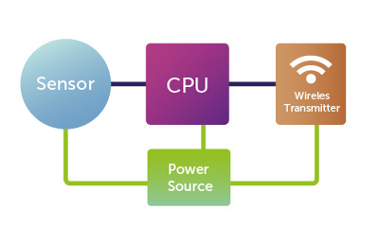
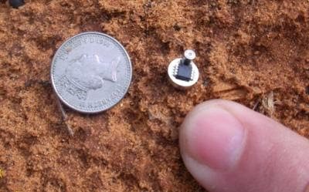
Introduction
Sensor laden computer nodes
Size – cubic milli meters
Combination of power supply, sensor and communication mechanisms.
To gather information around surroundings
To monitor various parameters like temperature, humidity, motion, motion,
light levels, pollution, chemicals etc.,
A cubic millimetre battery can store 1J and could be backed up with a solar
cell or vibrational energy source.

Slide 3
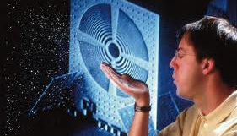
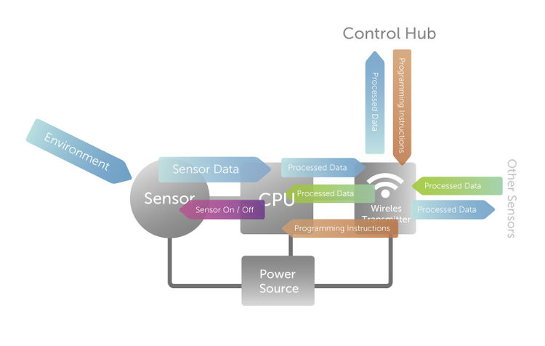
Working
Smart dust nodes- run by a microcontroller
- Determines the task to be performed by the mote
- Controls power
Microcontroller consists of tiny sensors for recording various types of data.
Sensors run by timers.
Data is sent to the base controlling station.
Most of the time, mote is off with only timers running.
When a timer expires, it powers mote to carry out a job , then powers off.

Slide 4
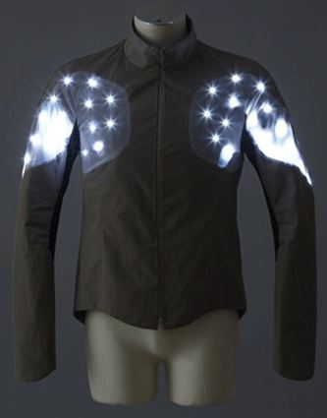
Smart Dust in Real World
IT sector, military, medical and environment monitoring
Battle field surveillance
Detection
Tracking of enemy vehicle
Spread by Unmanned Air Vehicles (UAVs)
Monitoring speed and volume of traffic to avoid recurring traffic jams
To monitor health status and curing situations using smart dust
To enter human bodies and check for physiological problems

Slide 5
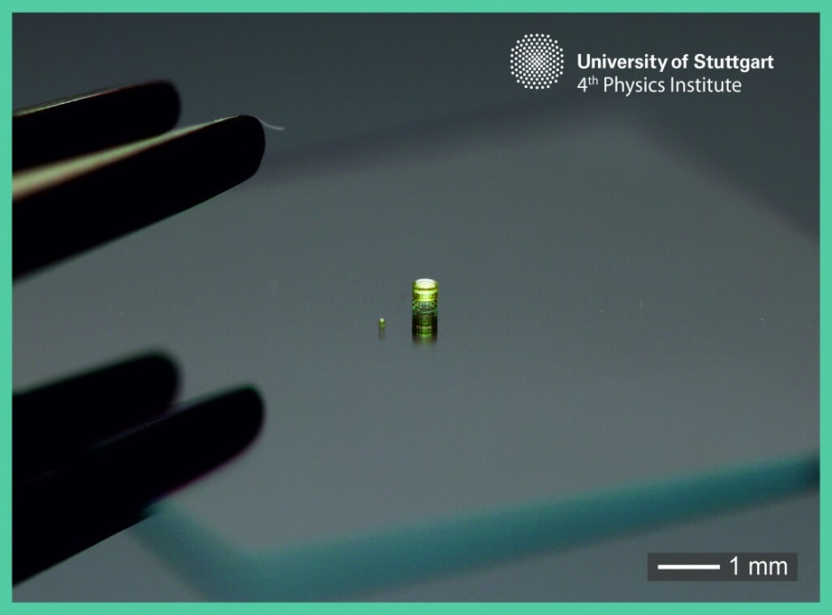
Conclusion
Miniaturization is one of the most world-shaking trends of the last
several decades.
A multi-lens system (right) next to a single doublet lens (left).
Tech Giants, Cisco Systems and IBM have started investing millions
of dollars to employ smart dusts in systems and networking technology.

